Slide 1
ENGG406 Course Overview
Hazards
Risk Based Process Safety; Hazard ID; Risk Management Concepts; Fires, Explosions & Releases
Inherent Safety
Inherently Safer Design; Bhopal Loss Incident
Design
Facility Siting, Hazardous Area Classification; Regulations; Occupational Health & Toxicology
Operations
Risk Assessment
Safeguards
Alarms
Pre-Startup Safety Review; Management of Change; Human Factors; Flixborough Incident; Phillips 66 Polyethylene Plant incident (Pasadena, TX); Marathon Texas City Refinery HF Release; Emergency Management; Key Performance Indicators; Audits; PSM frameworks
Independent Layers of Protection; Basic Process Control Systems; Safety-Instrumented Systems; Safety System Impairment; BP Texas City Incident
Overpressure protection; specialized safeguards; asset integrity/barrier analysis
Chemical Reactivity; What-if; HAZOP; FMEA; Event Tree; Fault Tree; Dispersion & Consequence Analysis; Layer of Protection Analysis (LOPA); Dow FEI & CEI tools; BowTie; Safety Integrity Level; Piper Alpha & BP Macondo incidents
Guest Lecture
Organizations
U of A Faculty of Medicine & Dentistry; Alberta Boilers Safety Association (ABSA); Syncrude; Imperial Oil; Chevron; Dow; NOVA Chemicals; Shell; C-FER; Top Hat

Slide 2


ENGG406
A Course in Process Safety
Engineering Safety –
Methodologies & Tools
The David and Joan Lynch School of Engineering Safety and Risk Management
Q: Why should you consider taking this course?
A: You have ENGG404 “Leadership in Risk Management” … now build on it!

Slide 3

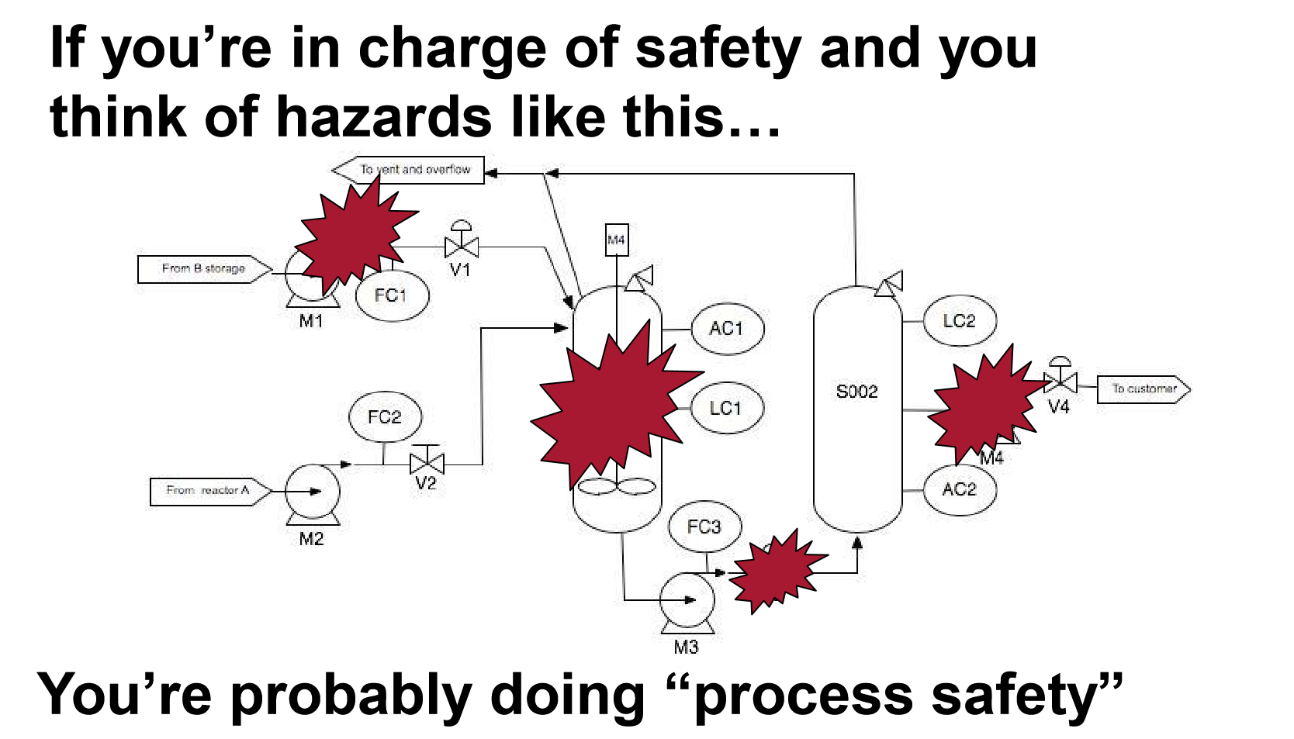
Process Safety vs. Occupational Safety

Slide 4
Key Definition: Process Safety
A disciplined framework for managing the integrity of operating systems and processes handling hazardous substances by applying good design principles, engineering, and operating practices.
It deals with the prevention of incidents that have the potential to release hazardous materials or energy, and the mitigation or control of those incidents should they occur.
Process safety incidents:
“extremely low frequency but extremely high impact”.
Such incidents can cause toxic effects, fire, or explosion and could ultimately result in serious injuries, property damage, lost production, and environmental impact.

Slide 5
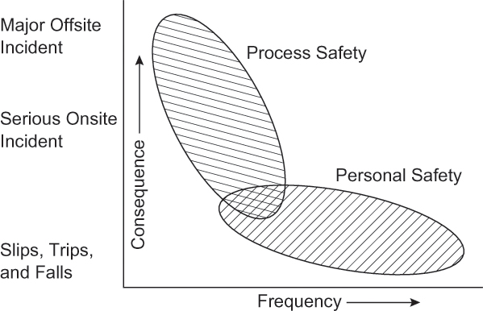
Process Safety vs. Occupational Safety
ENGG406

Slide 6
Why is Process Safety Important to Industry?
You will be confronted with a myriad of risks during your career.
You will be expected to manage those risks all of them.
You will need to know methodologies & tools that can be used to assess the consequences, likelihoods, and risk exposures at all facilities and plant operations.
You will need to identify hazards and develop rational risk reduction solutions to prevent loss incidents.
You will need to lead your organization in deciding on how to manage risk by: identifying, analyzing, evaluating , & assessing them against some acceptable criteria.
Then, you will be asked to find cost effective solutions.
With the ultimate goal of preventing process safety loss incidents.

Slide 7
What is ENGG406?
ENGG404 is about concepts and applications of leadership, culture, people, and organizations.
ENGG406 is more of a technical safety course than ENGG404 as it has a focus on the tools and methodologies for process safety risk management.
Process safety risk management is a complementary study to process design engineering, and is a great asset for those who desire a career in process design or in process / plant operations e.g. chemical engineers, mechanical engineers in process technologies, management/industrial engineers

Slide 8
ENGG404 vs. ENGG406
ENGG406
lots of tools
Technology:
engineering safety
tools and methods
ENGG404
Leadership concepts
Leadership Competencies

Slide 9
ENGG406 Overview & Emphasis:
Assess process safety risks inherent in any operation and determine appropriate risk reduction solutions.
Apply proactive risk assessment work processes, tools, and methodologies for: hazard identification, analysis, evaluation, assessment, and process safety management.
Learn in a smaller class size where you will have opportunities to discuss questions posed, collaborate with your peers, and interact with industry experts.
Learn from others by using these new concepts, tools, and methodologies in your assignments.

Slide 10
Benefits to You by taking ENGG406!
Build your expertise in this field by taking ENGG406, and get a step ahead of the competition in your career.
Energy and related industrial companies value those who have leadership in risk management.
So, why not add expertise in process safety risk management and further build your prospects!

